Slide 1
Take a Break
Names

Slide 2
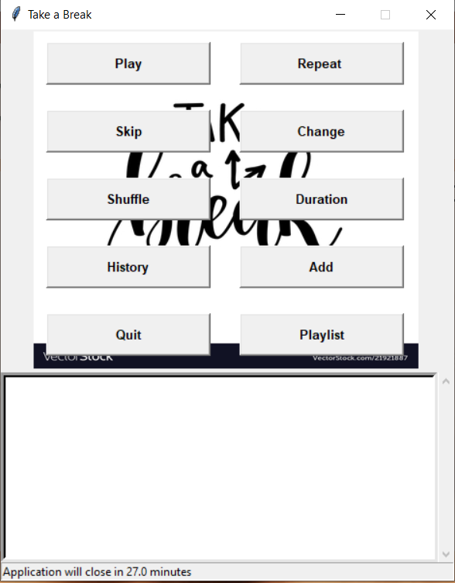
Objective
Our objective is to a design an application that serves as a refresher app.
We can create a playlist of our favourite songs, or motivational videos, or sports highlights.
Our playlist should have all the basic features of any playlist such as add, skip, shuffle, change.

Slide 3
Outline
Architecture
Describes the overall schema of the application.
Frontend
Designed using Python package tkinter.
Backend
Contains all the functional modules in the application.
Database
Uses a SQL Server database to store the songs and details.

Slide 4
Architecture
Backend
(Python)
Contains all functional modules
UI
(Tkinter)
DataBase
SQL Server

Slide 5
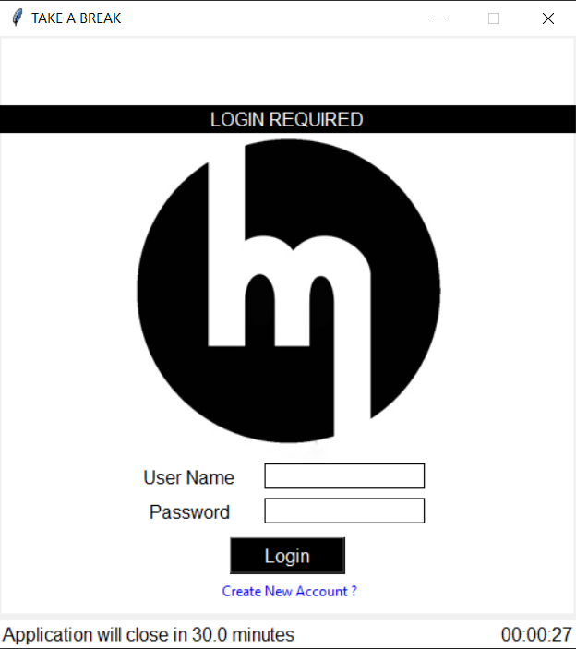
Front End(1)
We have designed our frontend using Tkinter package.
First page is the login screen.
For existing users - it prompts us to enter the user name and password.
For new users, it allows them to create a new profile. Their credentials are stored in users table in the database.
Only if the username and password match the ones present in DB, the user is logged in.

Slide 6
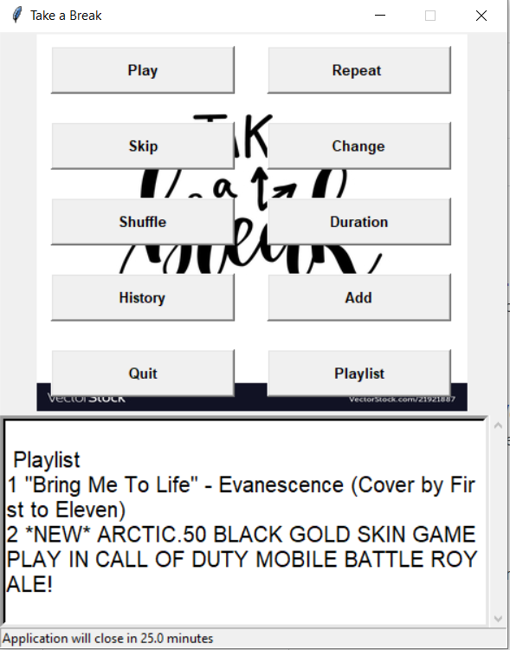
Front End(2)
After we log in, we are shown all the functions in the app.
In the bottom, we see the display pane.
It shows song details/ what song is currently being played, duration of song based on what function we click.
Below that, we see the application run time.
As soon as the application has run for 30 minutes, it automatically closes.

Slide 7
Back End
In total, there are 10 functions available in our application.
Let’s see how each function works.

Slide 8
Database(1)
We store all user info and playlist details in database.
We have 3 tables.
Users
Playlist
History
USERS
id username fullname email password
1 1 Ajith ajith.murugaian@gmail.com a

Slide 9
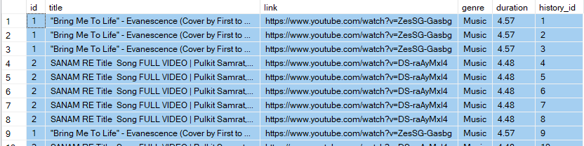
Database(2)
Playlist
History
Id in the playlist table is the primary key of playlist. It is linked to id in history table using a foreign key relationship.

Slide 10
Modules
Play
It asks the user what genre video he wants to watch.
It displays all the videos present in our playlist for that particular genre in the display pane.
When we type the title and click ok, it searches for the title in playlist table, finds the corresponding link and plays the video in a new tab.
Repeat
It repeats the last viewed video. It checks the history table for the last played video and plays that video.
Skip
It skips the next song and plays the song after that. Finds the id of the next song, increments the id, plays the song after that.

Slide 11
Modules
Change
It asks the user next what genre video he wants to watch.
After that, we follow the same approach that we did in play function.
Shuffle
It reorders the videos in the playlist table and displays them in the new order. It is helpful when we have a lot of videos.
Duration
It displays the duration of the current video in minutes in the display pane.
History
All the previously viewed videos are stored in the history table. This function prints the recent watch history in the display pane.

Slide 12
Add
If we want to add a new video to our playlist, then we use the add function.
It prompts the user to enter title, url, genre and duration of the video.
When we click add, a new entry is recorded in the playlist table.
Playlist
Displays all the videos in our playlist in the display pane.
Quit
Exits the application.

